Slide 1
5 Algorithems and Hyperparameters
About: MNN, RNN, LSTM, GRU, and CNN

Slide 2
Multi-layer Neural Network
Multi-layer Neural Network, also called Multi-layer Perceptron, is developped by many neural nodes to capture features in different layers, such as input layer, hidden layer, and output layer.
Principle:
Foward Propagation: pass weighted inputs with bias that are modified by activation functions to produce an output.
Activation Function:introduce non-linearity into neural networks, enabling them to learn complex patterns and model non-linear relationships in data.
Back Propagation: the process of updating the weights of each layer by calculating the gradients of the loss function with respect to these weights and bias.

Slide 3
Multi-layer Neural Network
Epoch1:
Batch Iteration1,
Batch Iteration2,
...
Epoch2:
Batch Iteration1
Batch Iteration2,
...
...
Large Batch Size leads to faster computation but may cause convergency probem.
More rounds of Epoches increases the accuracy of model but may cause overfitting.

Slide 4
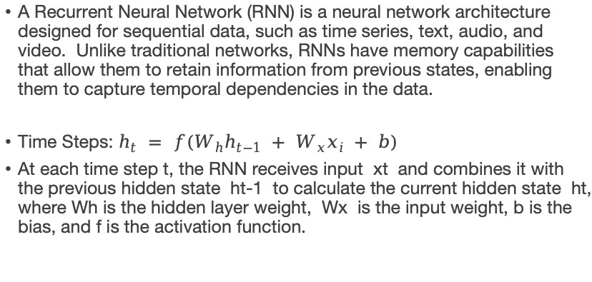
Recurrent Neural Network
A Recurrent Neural Network (RNN) is a neural network architecture designed for sequential data, such as time series, text, audio, and video. Unlike traditional networks, RNNs have memory capabilities that allow them to retain information from previous states, enabling them to capture temporal dependencies in the data.
Time Steps: $h_{t} = f(W_{h}h_{t−1} + W_{x}x_{i} + b)$
At each time step t, the RNN receives input xt and combines it with the previous hidden state ht-1 to calculate the current hidden state ht, where Wh is the hidden layer weight, Wx is the input weight, b is the bias, and f is the activation function.

Slide 5
Long Short-Term Memory
Long Short-Term Memory (LSTM) networks are a special architecture of RNN that effectively capture long-range dependencies in sequential data, addressing the vanishing gradient problem, by designing gating mechanisms to control the flow, retention, and forgetting of information, thereby capturing long-term dependencies more effectively. They are widely used in tasks like language modeling and speech recognition.

Slide 6
Long Short-Term Memory
Cell State:
The cell state is a key component of LSTMs, acting as a memory that carries information through the sequence. It runs through the entire chain of LSTM units, allowing it to maintain information over long periods.
Gates:
LSTMs utilize Forget Gate, Input Gate, and Output Gate to control the flow of information into and out of the cell state:
Forget Gate determines what information to discard from the cell state.
Inpute Gate decides what new information to add to the cell state.
Output Gate determines what part of the cell state to output.

Slide 7
Gated Recurrent Units (GRU)
Gated Recurrent Units (GRU) are a type of Recurrent Neural Network (RNN) designed to improve upon the traditional RNN and Long Short-Term Memory (LSTM) architectures by simplifying their structure while maintaining their ability to capture long-range dependencies in sequential data.
1. Update Gate (zt): Controls the balance between past and new information.
2. Reset Gate (rt): Determines how much of the previous hidden state to forget.
3. Efficient Structure: Fewer parameters than LSTMs, making GRUs faster to train while maintaining performance on sequential tasks.

Slide 8
Convolutional Neural Network (CNN)
Convolutional Neural Networks (CNNs) are a class of deep learning models specifically designed for processing structured grid data, such as images. They are particularly effective in tasks involving image classification, object detection, and image segmentation due to their ability to automatically learn spatial hierarchies of features.
1. Convolutional Layers: Use small filters to scan over the input (like an image) and find patterns (like edges or textures). Each filter creates a feature map that highlights these patterns.
2. Pooling Layers: Reduce the size of the feature maps (usually by taking the maximum or average value) to make the model faster and to keep important information while discarding the less important details.
3. Activation Functions: Add non-linear effects (like ReLU) to the model, allowing it to learn more complex patterns in the data.
4. Fully Connected Layers: Combine all the features from previous layers to make final predictions, similar to how traditional neural networks work.
5. Dropout Layers: Randomly ignore some units during training to help prevent overfitting, which is when the model learns too much from the training data and doesn’t perform well on new data.

Slide 9
Hyperparameter
Epochs: An epoch is one complete pass through the entire training dataset
Typical Range 10 to 1000,
Early Stop: Used to halt trainning when validation performance stops improving, preventing overfitting.
Batch Size:The number of training samples used in one iteration of model training.
Small Batch Size - 1 to 32, Medium Batch Size 64 to 256, Large Batch Size - 512 to 4096
Hidden Layers:
1 to 10 layers for most application.
more than 10 layers - Deep Network, used in complex task like imag and speech recognition, but can lead to vanishing/exploding gradients.
(More hidden layers can increase the model’s capacity but may also lead to overfitting.)

Slide 10
Hyperparameter
Neurons: The number of neurons in each hidden layer.
10 to 1000 neurons: Commonly used range; simpler tasks might use fewer neurons, while more complex tasks require more.
Heuristic: Start with a size that is a fraction of the input size and adjust based on performance.
Activation Function:A function that determines the output of a neuron given inputs.
ReLU (Rectified Linear Unit): Widely used in hidden layers; helps mitigate vanishing gradient issues.
Sigmoid: Output layer for binary classification; outputs values between 0 and 1.
Tanh (Hyperbolic Tangent): Similar to sigmoid but outputs values between -1 and 1; often preferred over sigmoid.
Softmax: Used in the output layer for multi-class classification; outputs probabilities that sum to 1.

Slide 11
Hyperparameter
Dropout Rate: A regularization technique where a fraction of neurons is randomly dropped during training to prevent overfitting.
0% (no dropout): Indicates no dropout regularization.
0.1 to 0.5: Commonly used dropout rates; 0.2 to 0.3 is a good starting point for many applications.
(Consideration) A higher dropout rate can prevent overfitting but may also hinder learning if set too high.
Loss Function:A function that measures how well the model’s predictions match the actual outcomes.
Mean Squared Error (MSE): Used for regression tasks; measures average squared difference between predicted and actual values.
Binary Cross-Entropy: Used for binary classification tasks; measures the performance of a model whose output is a probability value between 0 and 1.
Categorical Cross-Entropy: Used for multi-class classification tasks; measures the difference between two probability distributions.
Sparse Categorical Cross-Entropy: Similar to categorical cross-entropy but used when the target class labels are integers instead of one-hot encoded vectors.

